Slide 1

Twitter Application Programming Interface(API) by
Nayana Mahajan
Data Collection

Slide 2
Table of contents
What is API?
Twitter API
How does it work?
Introduction to Tweepy Library in Python
Introduction to Open Authentication (OAuth)
Steps for Data collection
Code Snippets

Slide 3
What is API?
An API is an interface implemented by a software program that enables it to interact with other software. Consider it similar to the way the user interface facilitates interaction between humans and computers
API is the messenger that takes requests and tells a system what you want to do and then returns the response back
Through the API you are able to call functions from web service

Slide 4

Twitter API
Twitter allows you to interact with its data tweets and several attributes about tweets using Twitter APIs
Twitter API can be accessed only via authentication requests
You need to apply for Twitter developer access via the below URL
https://developer.twitter.com/
After you have applied for Developer Access, you can create an application on Twitter that you can use to access tweets. Make sure you already have a Twitter account
Twitter has several APIs like Search API, Rest API, and Streaming API

Slide 5
How does it work
Server side scripting language (in our case python) make requests to Twitter API and results would be in JSON format that can be easily read by our program
In our tutorial we are going to extract tweets via the python library “Tweepy”
Tweepy is an easy to use Python library for accessing the Twitter API

Slide 6
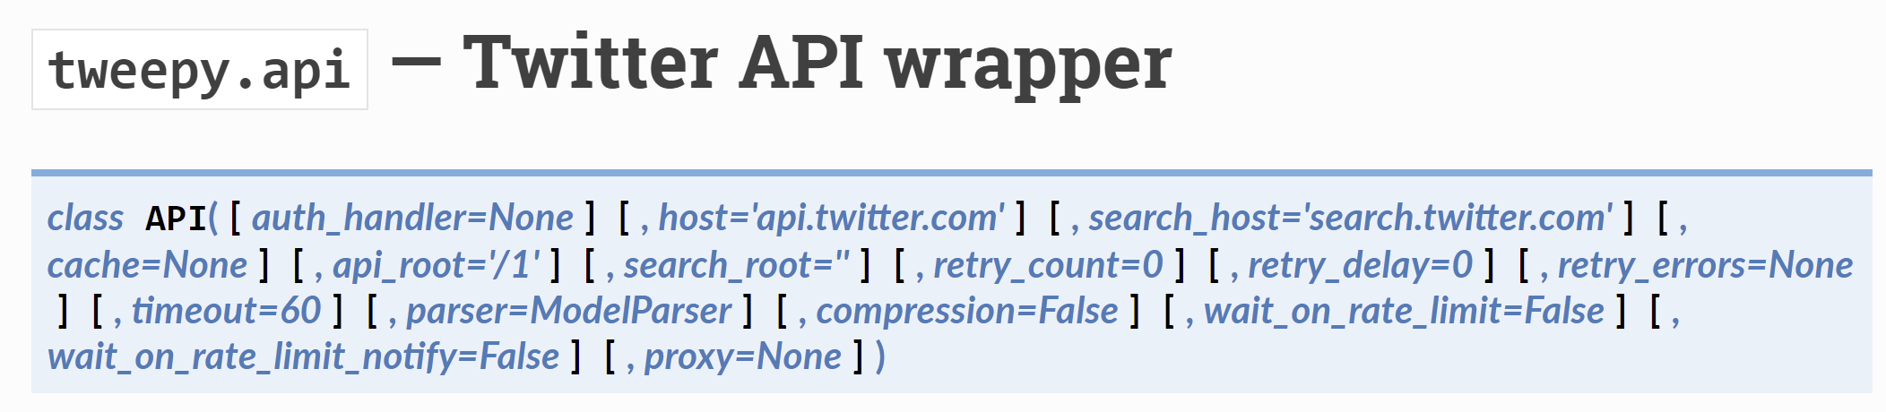
Introduction to Tweepy Library in Python
Tweepy is an open-source Python package that gives you a very convenient way to access the Twitter API with Python Data Extraction via API
Tweepy includes a set of classes and methods that represent Twitter's models and API endpoints, and it transparently handles various implementation details, such as Data encoding and decoding

Slide 7
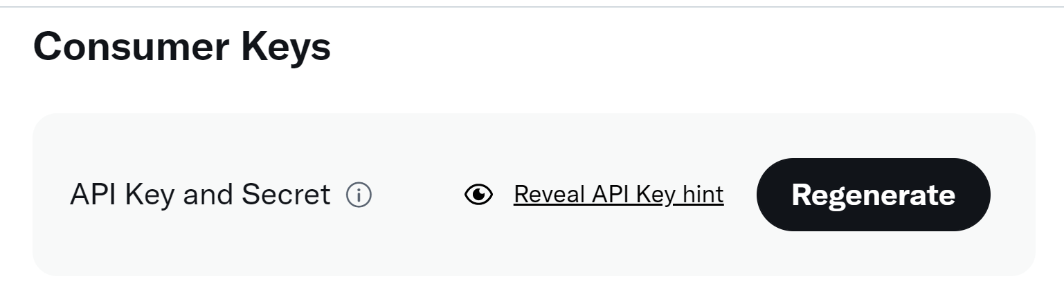
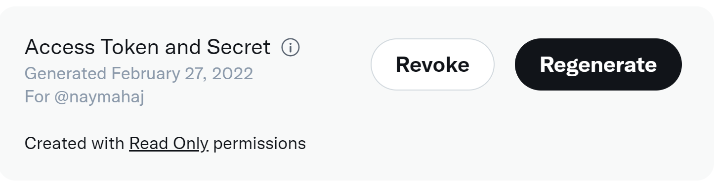
Introduction to Open Authentication(OAuth)
Twitter uses OAuth to provide authorized access to its API
There is no security issue
Once the developer account is created you will have access to your individual account consumer key, consumer secret key, access token and access token key

Slide 8
Introduction to Open Authentication(OAuth)
User
Registers on Twitter to access APIs
Google Colab
Enter Credentials
Directs user to Twitter to verify user credentials
Request access token using the OAuth verifier, consumer token and secret
Request for content using access token and secret
2
1
3
4
Twitter
Issues the consumer token and secret
Validates credential and issues a OAuth verifier
Issues access and token secret
Responds with requested information

Slide 9




Steps for Data Collection
API
Application
Data collection

Slide 10

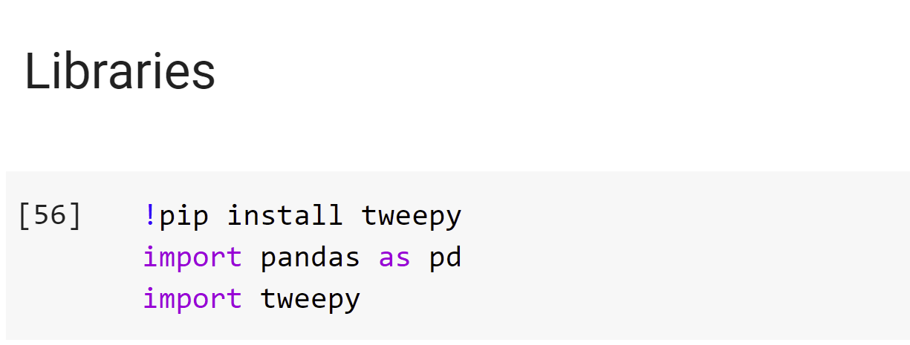
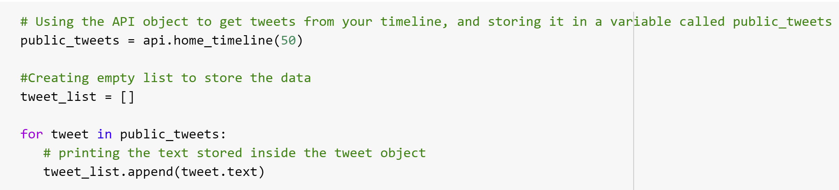
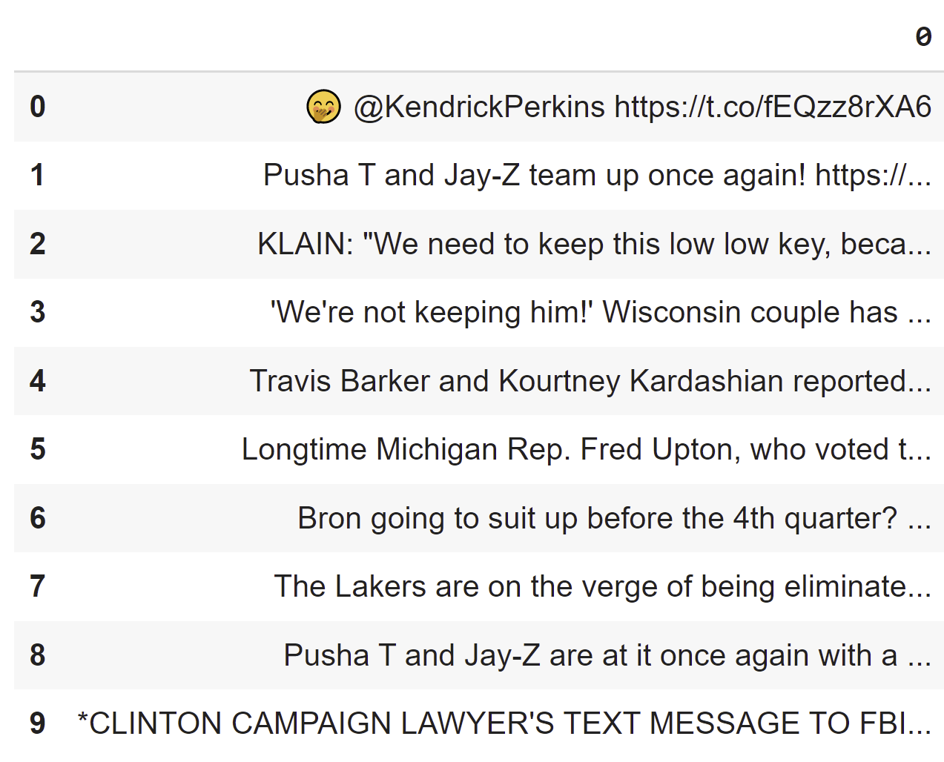
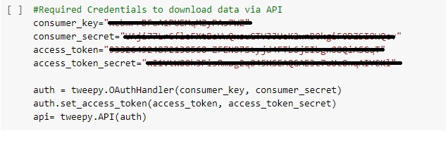
Code Snippets
Required Library
Case 1:
Connecting to Twitter API

Slide 11

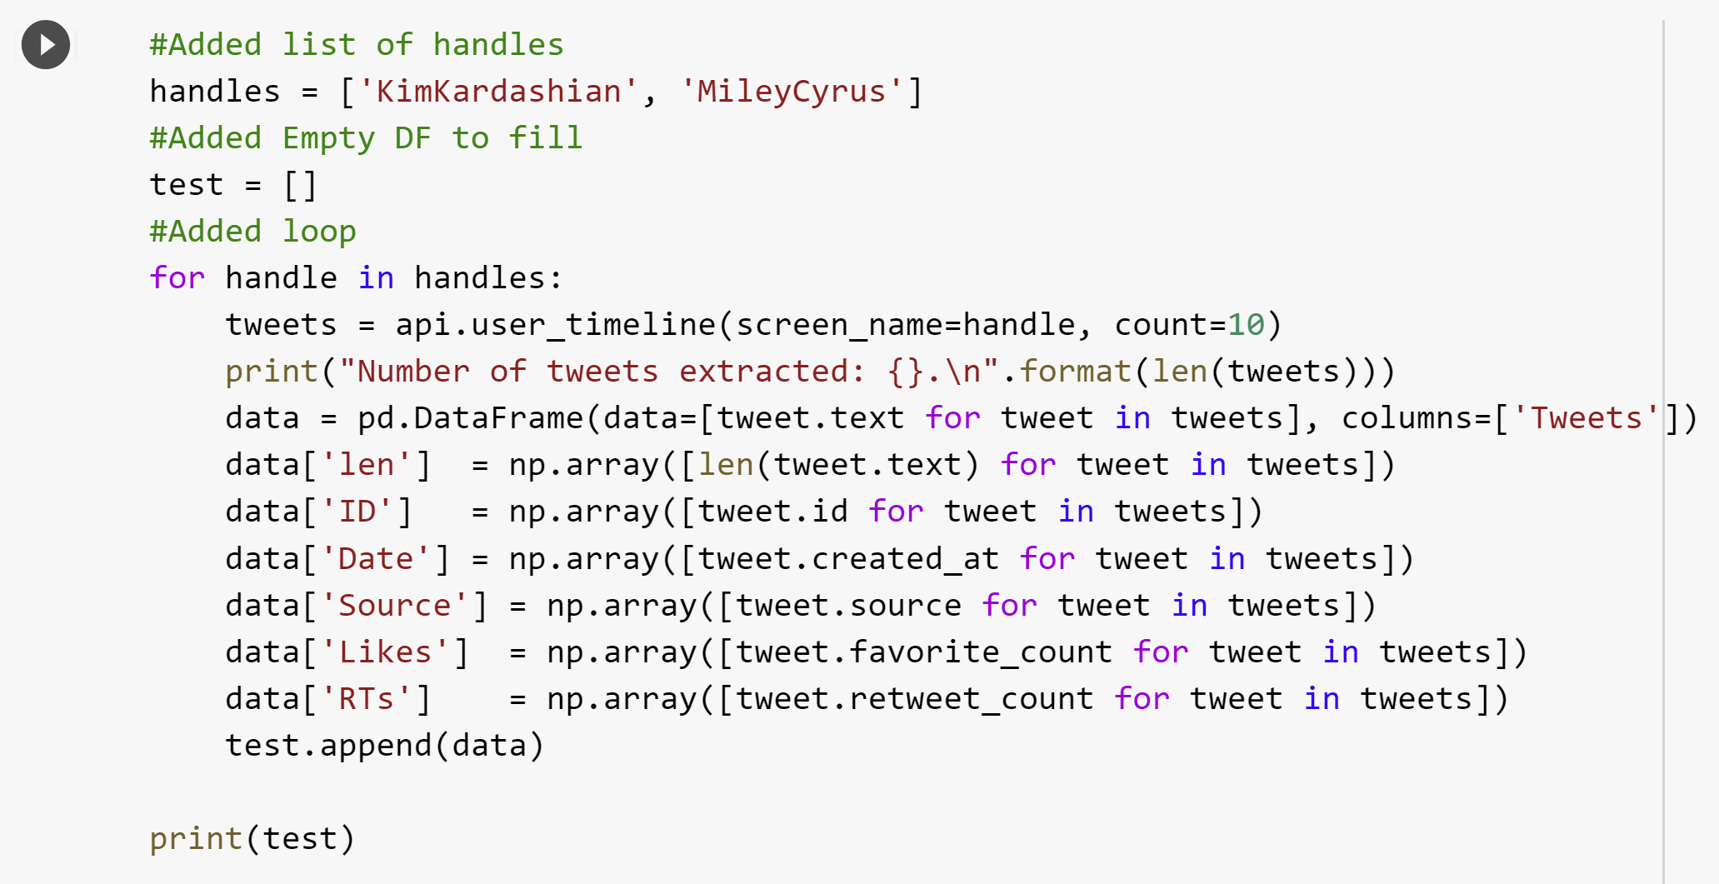
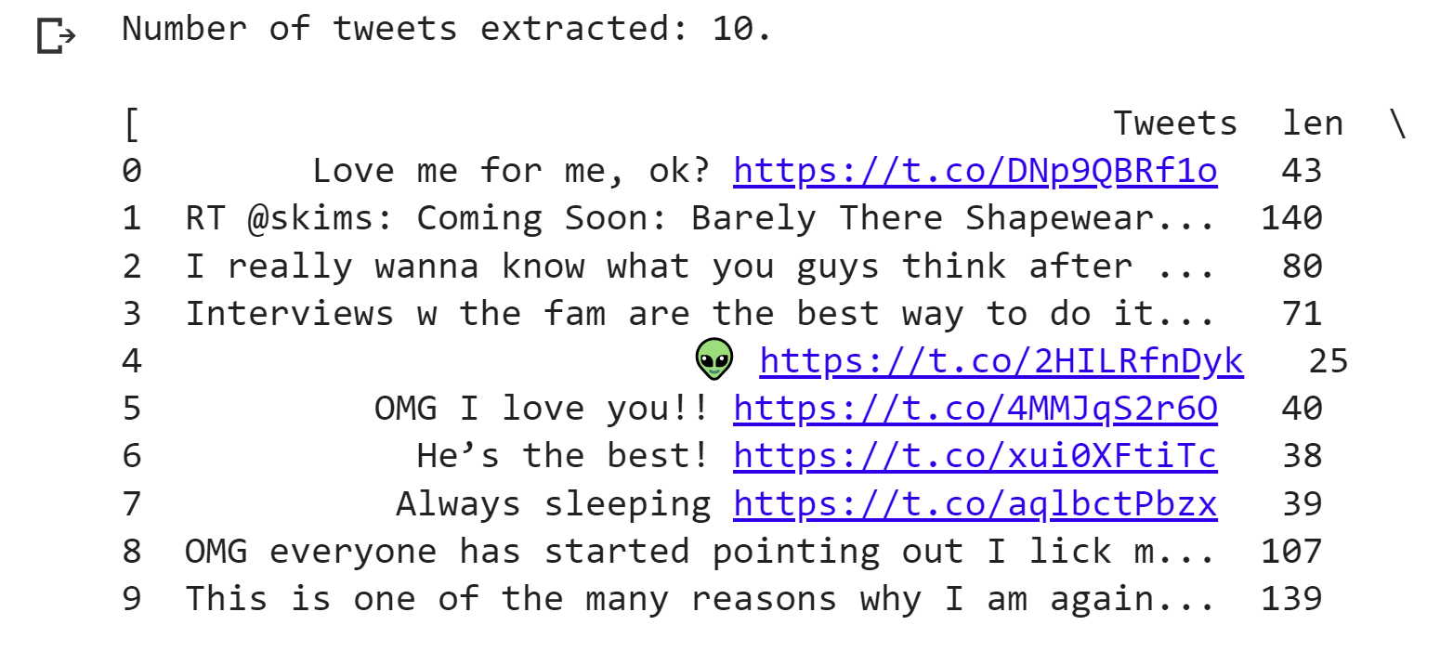
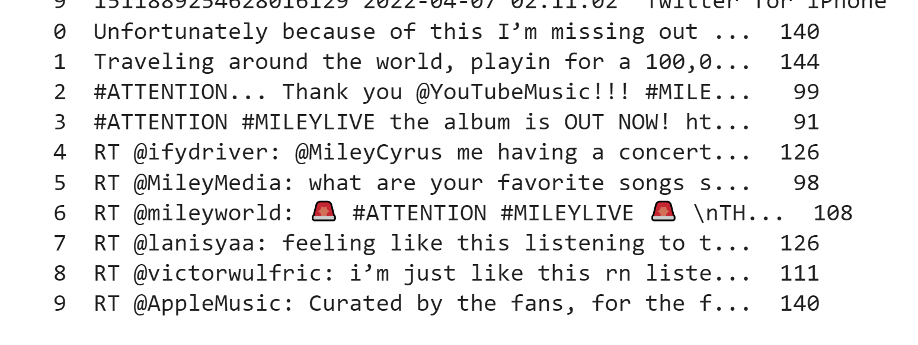
Code Snippets
Case 2:

Slide 12
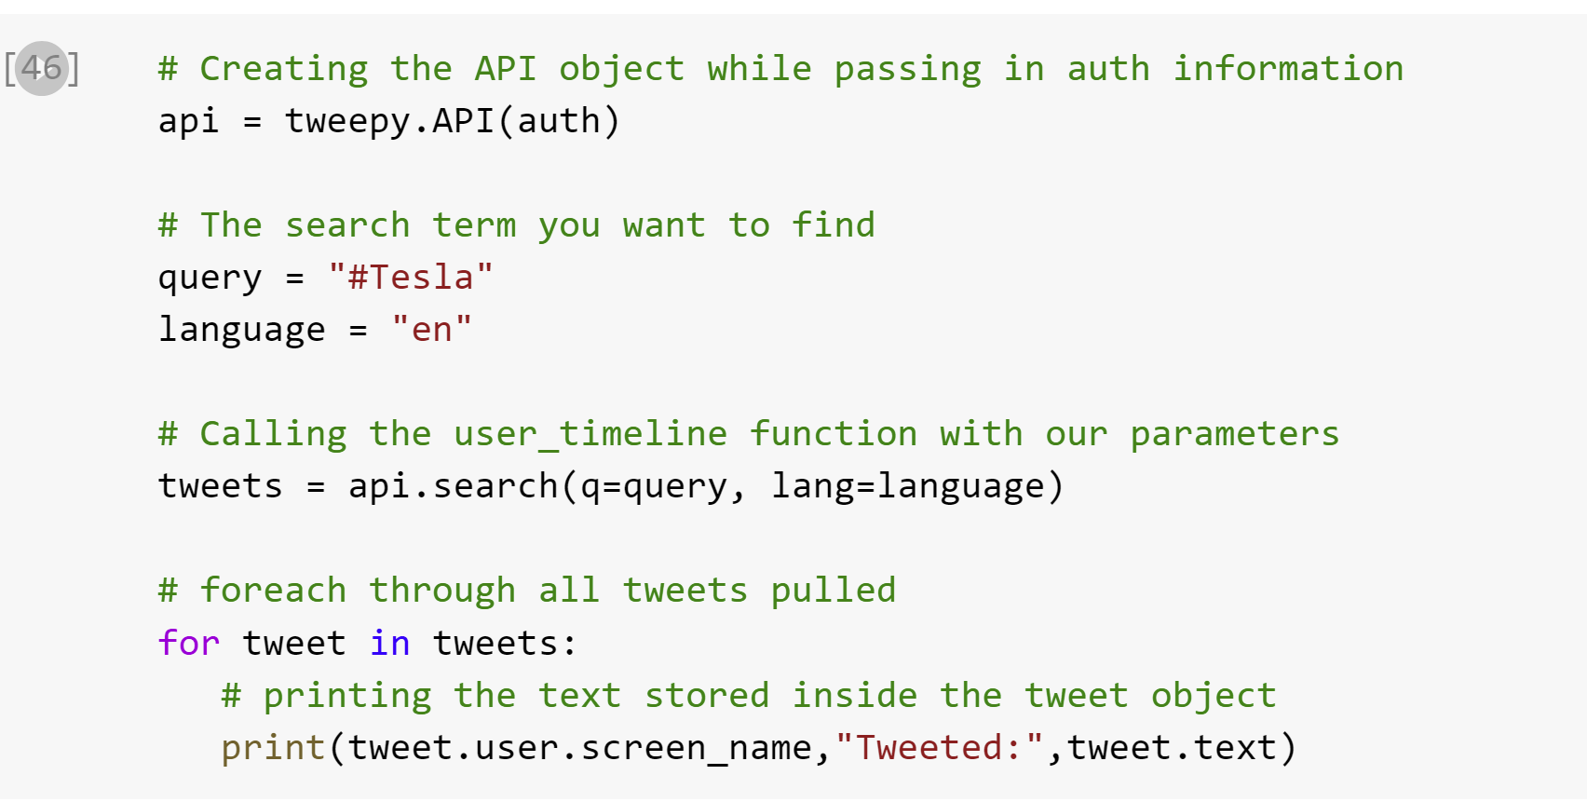

Code Snippets
Case 3:

Slide 13
Thank you!

